Slide 1
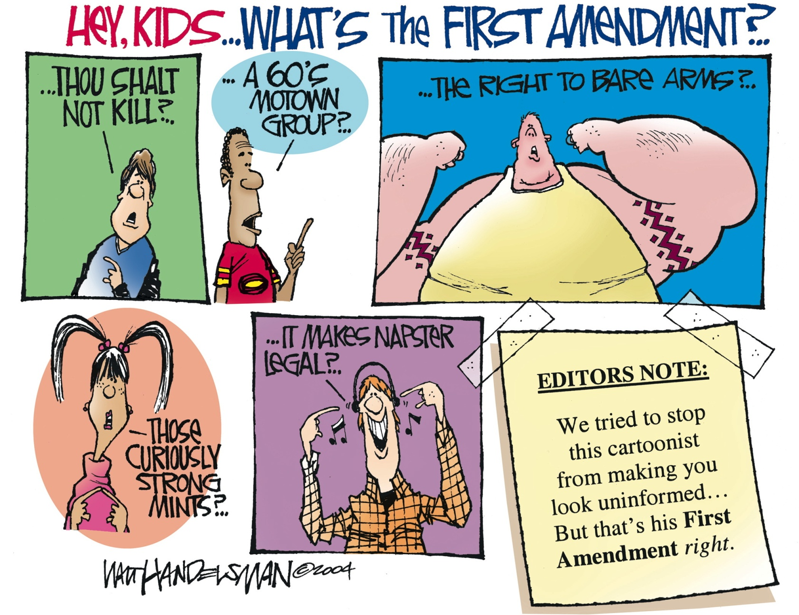
Another Look at “The First Amendment”

Slide 2
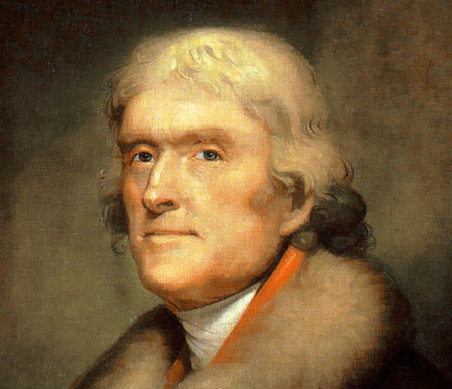
Origins of “The First Amendment”
Federalists (such as Alexander Hamilton and James Madison) and anti-federalists (such as Patrick Henry and Samuel Adams) debated the concept of federalism
Thomas Jefferson (a federalist) persuaded Madison to propose The Bill of Rights in Congress
Jefferson was most concerned about freedom of speech and freedom of religion—hence, the First Amendment

Slide 3
Another Look at the Text
“Congress shall make no law respecting an establishment of religion, or prohibiting the free exercise thereof; or abridging the freedom of speech, or of the press; or the right of the people peaceably to assemble, and to petition the Government for a redress of grievances.”
– “The First Amendment” of The United States Constitution

Slide 4
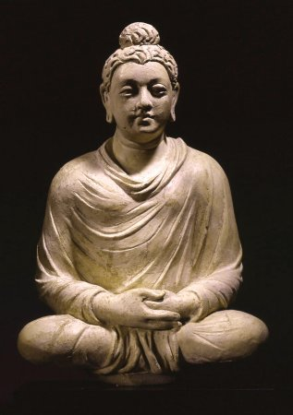
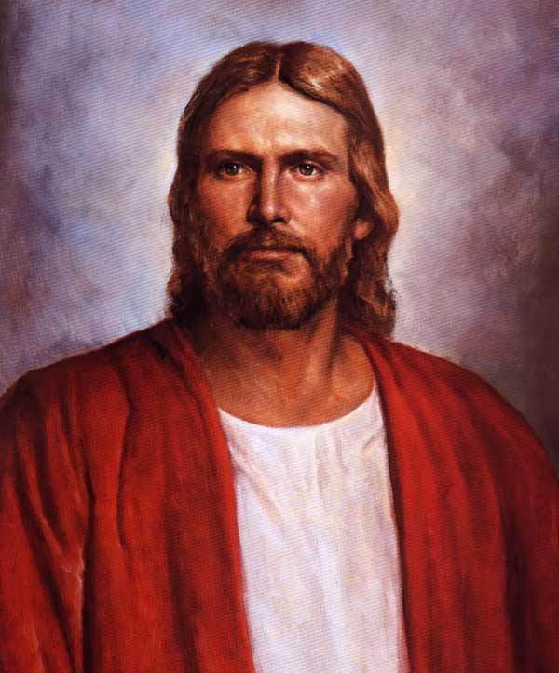
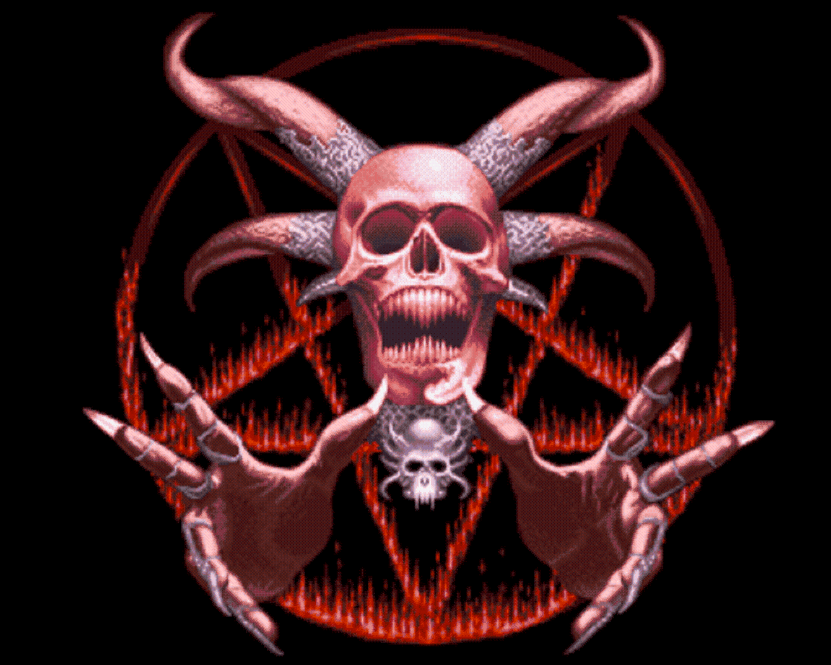
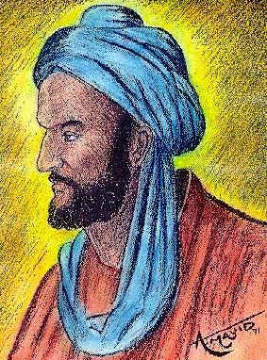
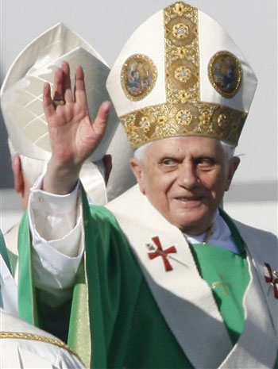
The Establishment and Free Exercise Clauses
The establishment clause:
Congress cannot establish a national religion
Congress cannot prefer one religion over another or non-religion over religion (or vice versa)
The free exercise clause:
Congress cannot prohibit the exercise of religion

Slide 5
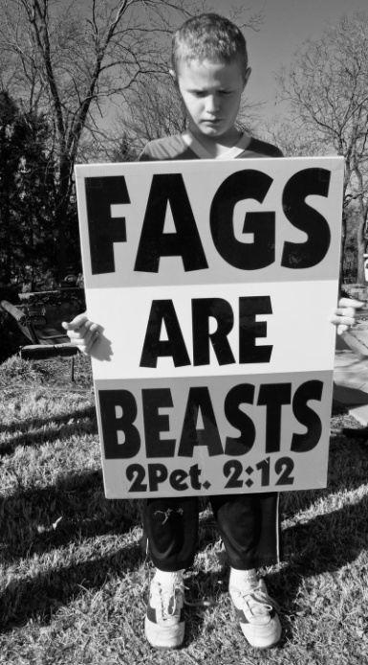
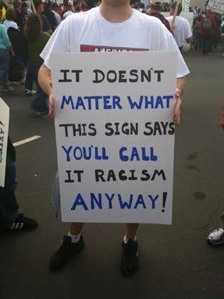
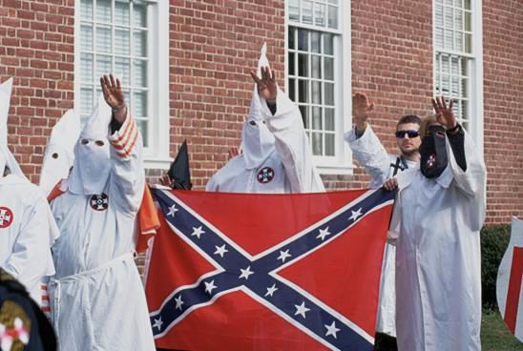
Freedom of Speech
You can criticize the government
You can use racist, sexist, or hateful speech (in most instances)
You can also be speechless (or silent)
Remember your Fifth Amendment Right to avoid self-incrimination

Slide 6
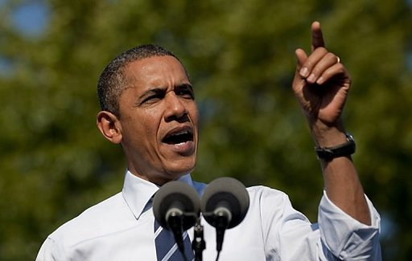
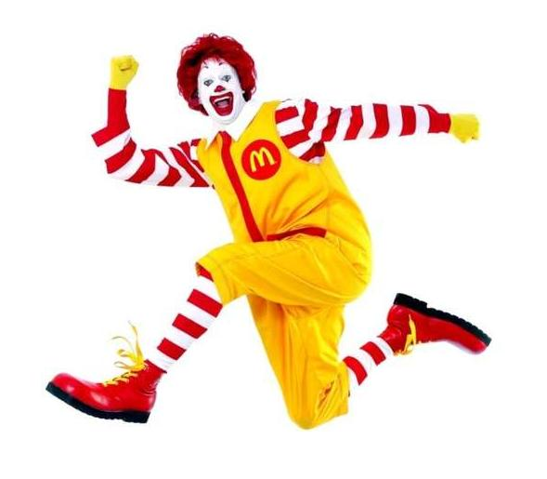
Freedom of Speech [2]
Core Political Speech
Interactive communications about political ideas or issues that are not motivated by profit
This is the most highly guarded form of speech because of its expressive nature and its importance to a functional republic
Commercial speech
Motivated by profit

Slide 7
Freedom of Speech [3]
Your freedom of speech is not absolute
Not all speech is free
Child pornography
Obscenity (See “The Miller Test”)
Imminent danger (yelling “Fire!” in a crowded theater)
Fighting words (threats of imminent or potential violence)
Commercial speech (advertisements)
Commercial works and discoveries (copywrites and patents)
Fair political campaigns (campaign finance laws)
Untruths (or lies) to harm others (defamation, slander, or libel)

Slide 8
The Miller Test
Developed in the 1973 case Miller vs. California
It has three parts:
Whether “the average person, applying contemporary community standards,” would find that the work, taken as a whole, appeals to the prurient interest
Whether the work depicts/describes, in a patently offensive way, sexual conduct specifically defined by applicable state law
Whether the work, taken as a whole, lacks serious literary, artistic, political, or scientific value
The work is considered “obscene” only if all three conditions are satisfied

Slide 9
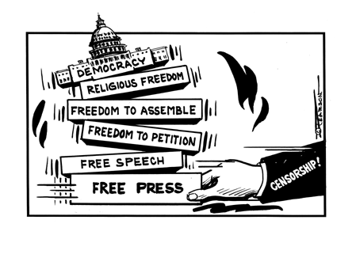
Freedom of the Press
Freedom to communicate and express ideas via electronic media and published materials
The “press” includes all media (printed, broadcasted, or televised)
We live in a marketplace of ideas

Slide 10
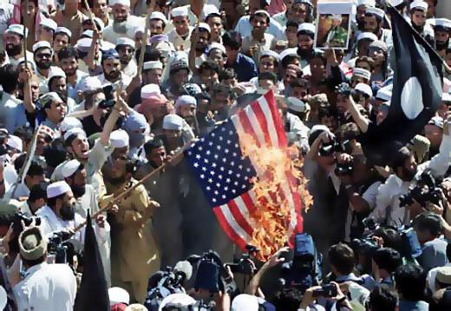
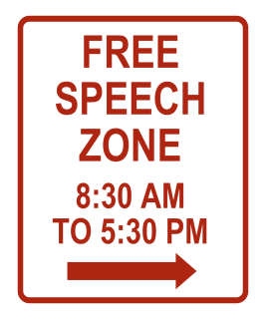
Freedom of Assembly
Freedom of association
The Right to “peaceably” come together and collectively express, promote, pursue, or defend common interests
Free speech zones

Slide 11
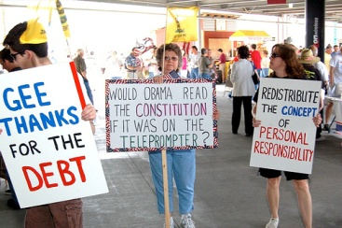
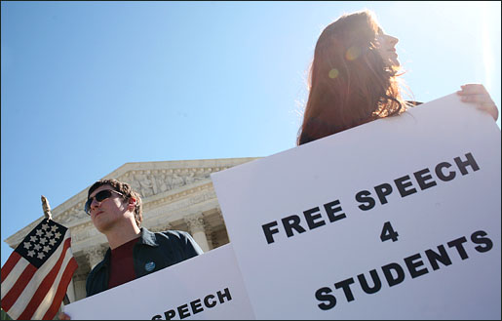
The Right to Petition
A “petition” is a formal request
Fundamental in representative democracy
Protects our public participation in government

Slide 12
Words of Wisdom
“Think for yourselves and let others enjoy the privilege to do so, too.”
– Voltaire, philosopher
“If the freedom of speech is taken away, then dumb and silent we may be led, like sheep to the slaughter.”
– George Washington, 1st president
“I am opposed to any form of tyranny over the mind of man.”
–Thomas Jefferson, 3rd president
“The dirtiest book of all is the expurgated book.”
– Walt Whitman, poet
“To suppress free speech is a double wrong. It violates the rights of the hearer as well as those of the speaker.”
– Frederick Douglass, social reformer

Slide 13
Words of Wisdom [2]
“Nature knows no indecencies; man invents them.”
– Mark Twain, author
“Free speech, exercised both individually and through a free press, is a necessity in any country where people are themselves free.”
– Theodore Roosevelt, 26th president
“Take away the right to say ‘fuck’ and you take away the right to say ‘fuck the government.’”
– Lenny Bruce, comedian
“You can cage the singer, but not the song.”
– Harry Belafonte, musician
“Censorship feeds the dirty mind more than the four-letter word itself.”
– Dick Cavett, talk show host

