Slide 1
Similes, Metaphors, Puns, Ironies, Symbols, Allusions, and Personifications

Slide 2
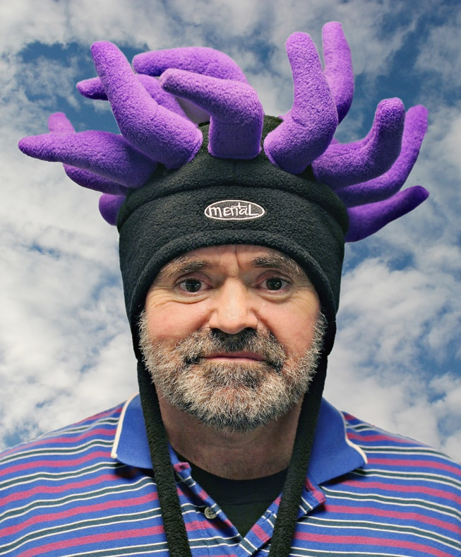
Similes
A simile is a comparison
“She’s like a tornado.”
“He smells like a fish.”
“They play soccer like a bunch of bums.”
We use these everyday!

Slide 3
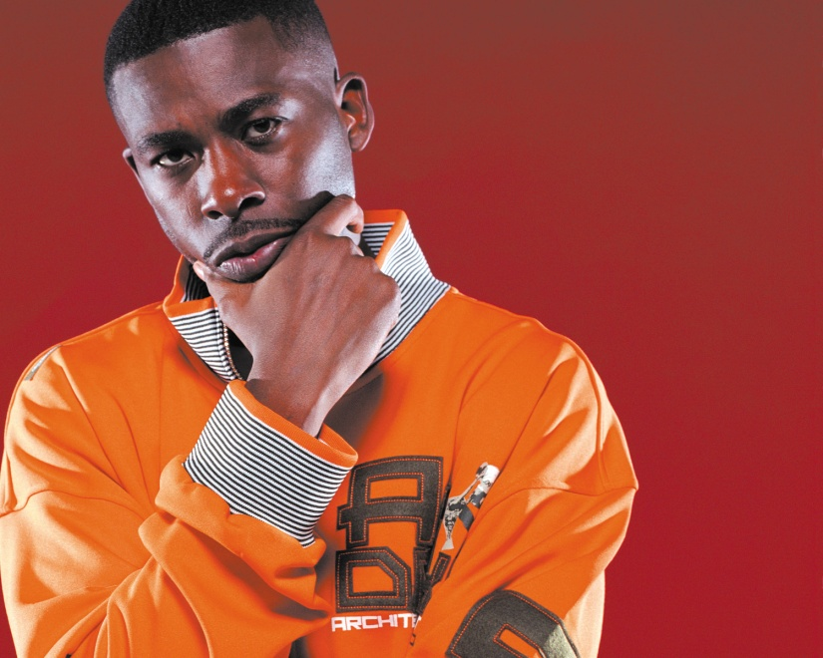
Metaphors
Like a simile, a metaphor is a comparison, but without the word “like”
“He’s a bomb, ready to explode.”
“She’s a pain in my ---.”
“Time flies on the wings of lightning.”
We use these often (but not as often as similes)

Slide 4
Puns
A pun is a play on words
Words have two meanings or may sound alike
Captain Aubrey: “Do you see those two weevils, Doctor? Which would you choose?”
Dr. Maturin: “Neither. There’s not a scrap of difference between them. They’re the same species of Curculio.”
Captain Aubrey: “If you had to choose. If you were forced to make a choice. If there were no other option.”
Dr. Maturin: “Well, then, if you’re going to push me. I would choose the right-hand weevil. It has significant advantage in both length and breadth.”
Captain Aubrey: “There, I have you! Do you not know that in the Service, one must always choose the lesser of two weevils?”

Slide 5
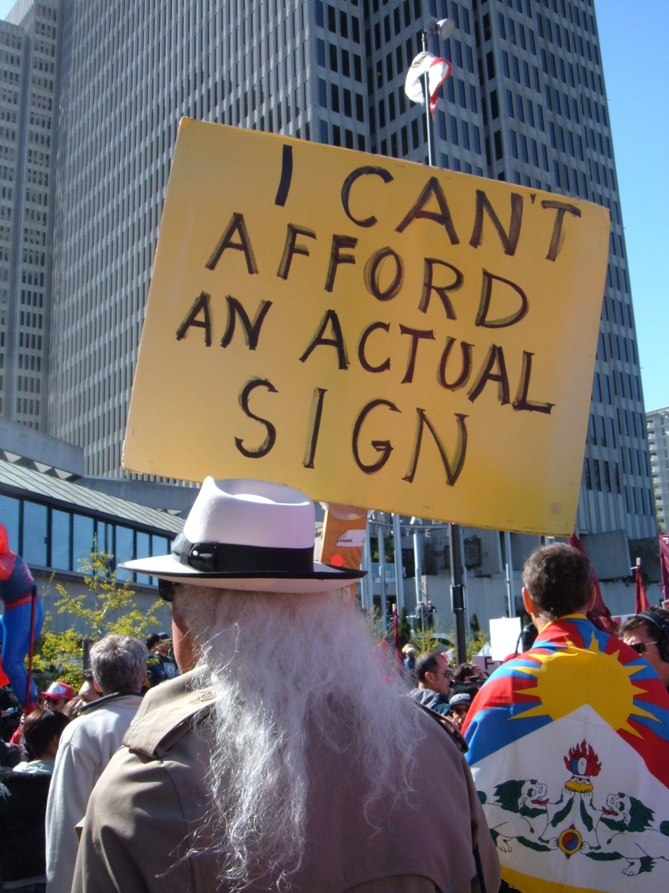
Ironies
An irony is something unexpected
Irony includes:
Absurdity
Biting wit
Drollness
Incongruity
Insincerity
Mockery
Paradox
Sarcasm
Satire

Slide 6
Symbols
A symbol is an object, a picture, a word, a sound, or a mark that represents something else
These babies are all over the place!

Slide 7
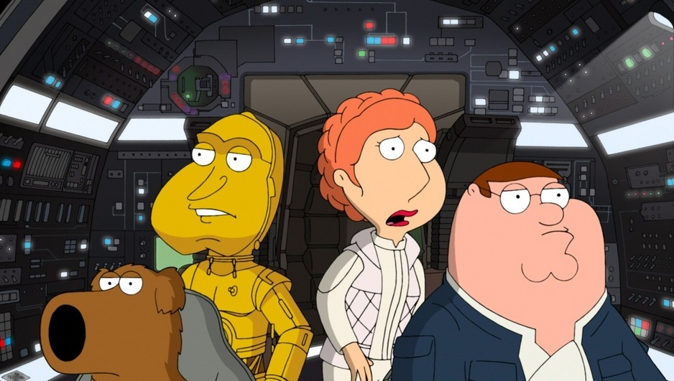
Allusions
An allusion is a hint, a mention, a parody, a reference, or a suggestion
These are also common

Slide 8
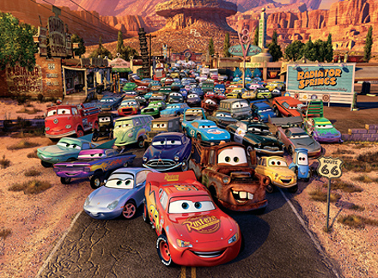
Personifications
Like a metaphor, a personification is a comparison
A thing or an idea is represented as a person
“The sun smiled brightly.”
“My computer hates my guts.”
“Opportunity knocked on my door.”

