Slide 1
An Introduction: Dandelion Wine
A Novel by Ray Bradbury

Slide 2
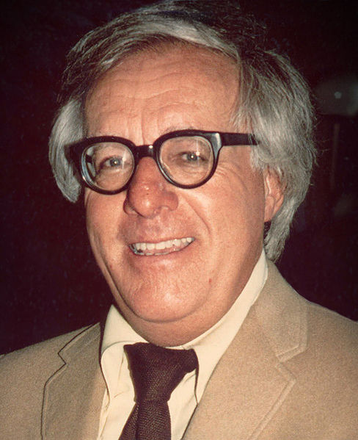
Who’s Ray Bradbury?
Born on August 22, 1920
Wrote fantasies, horror stories, science fiction stories, and mysteries
Best known for his dystopian novel Fahrenheit 451 (1953)
Born in Waukegan, Illinois, to a Swedish immigrant mother and a father who was a power and telephone lineman
His central character, Douglas Spaulding, from the novel Dandelion Wine, was drawn from this heritage
Dandelion Wine is his most personal work

Slide 3
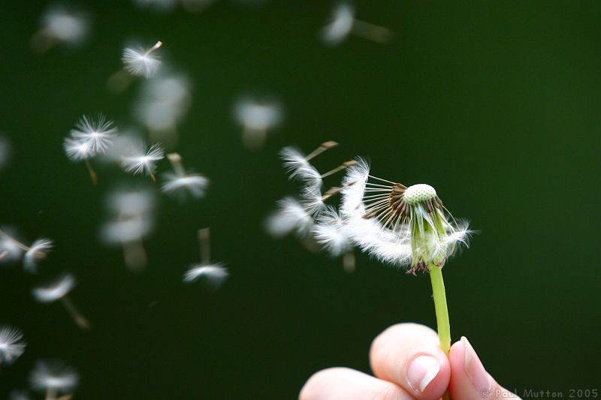
Prominent Themes
Life…yes, something as grand as life
Growing older, maturing, and gaining wisdom
Death
Time
Fear and acceptance
Technology

Slide 4
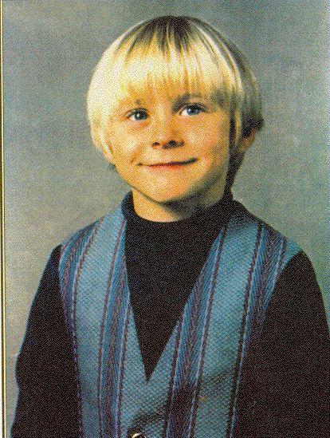
Main Characters
Douglas Spaulding, the protagonist
Tom Spaulding, Doug’s younger brother
Father and mother
Grandpa and Grandma Spaulding
Great-grandma Spaulding
Colonel Freeleigh
Leo Auffmann
Lena Auffmann

Slide 5
Guided Notes
As we read the text, you will be required to take notes
These are your “Guided Notes” (50 points)
This will be graded at the end of the quarter
We will take notes individually and as a class, depending on the lesson
If you’re missing notes, you will need to work with a fellow classmate outside of class
These notes will help you understand the novel

Slide 6
What to expect…
In addition to your Guided Notes, you will be accountable for the following:
The “Vocabulary Test” (15 points)
Two Dandelion Wine quizzes (20 points)
A Dandelion Wine-themed project (50 points)
A Dandelion Wine final exam
A “Participation Log” (25 points per day)
And remember…
You will receive points for Starters (10 points)

