Slide 1
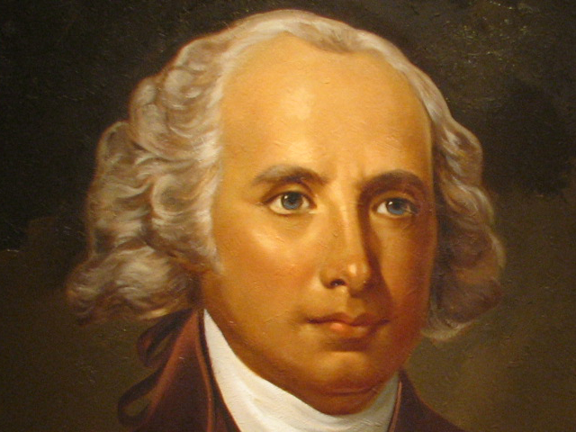
The Bill of Rights A Look at the First Ten Amendments

Slide 2
Overview
The first 10 constitutional amendments
Authored by James Madison
Proposed on September 25, 1789
Ratified on December 15, 1791
Limits the government
Details what the government can and cannot do regarding our personal liberties
Remember: The United States Constitution is the Supreme law of the land

Slide 3
The First Amendment
The Establishment Clause
The Free Exercise Clause
Freedom of speech
Freedom of the press
Freedom of assembly
The Right to petition

Slide 4
The Second Amendment
A well regulated militia
The Right to keep and bear arms

Slide 5
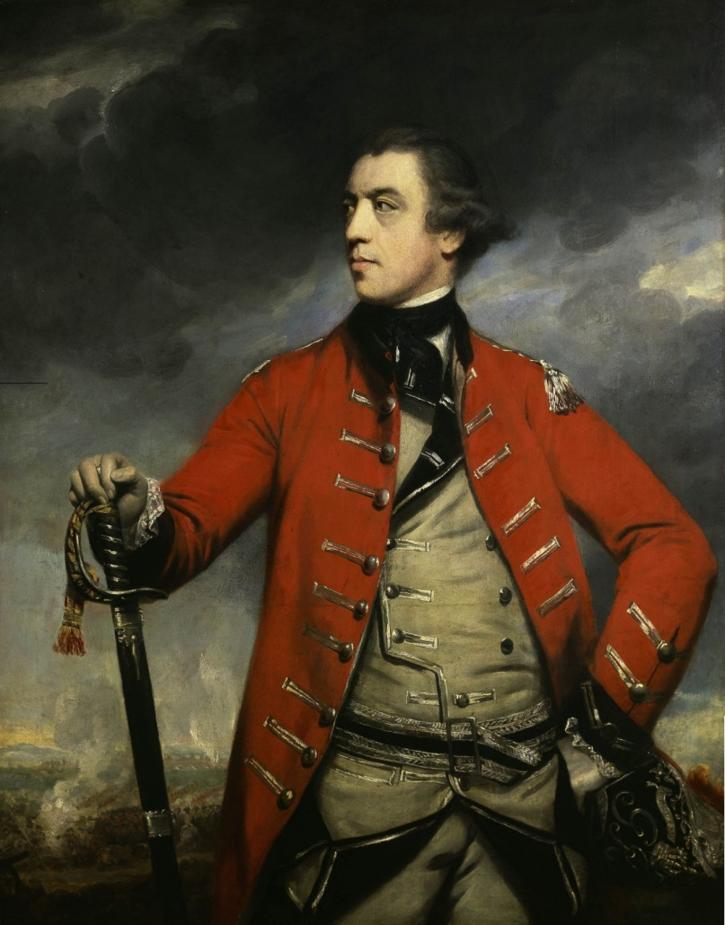
The Third Amendment
Troops cannot be quartered (or accommodated) in a private home without the owner’s consent

Slide 6
The Forth Amendment
The Right to be secure (in persons, houses, papers, and effects)
Law enforcement cannot search you or seize your property without a warrant

Slide 7
The Fifth Amendment
Those who commit serious crimes must be indicted by a grand jury
Double jeopardy: you cannot be tried for the same crime twice
Pleading the fifth: avoiding self-incrimination
Your Rights to life, liberty, and property cannot be taken without due process of law
Private property cannot be taken for public use without compensation

Slide 8
The Sixth Amendment
The Right to a speedy, public trial
The Right to an impartial jury
A notice of accusation
The defense must have an opportunity to “confront” and cross-examine witnesses
The Right to counsel

Slide 9
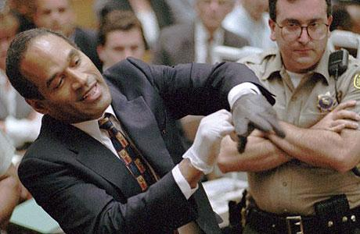
The Seventh Amendment
The Right to a trial by jury in suits of common law
“Common law” (and civil law) differs from criminal law
“Common law” refers to “case law” and “precedent”

Slide 10
The Eighth Amendment
No excessive bail
No excessive fines
No cruel and unusual punishments

Slide 11
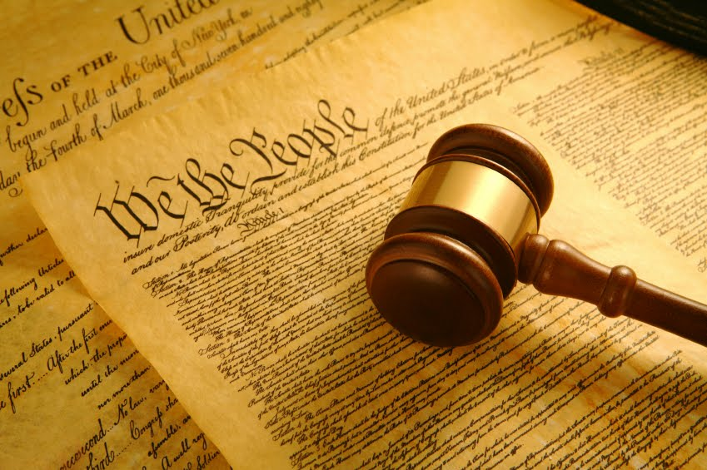
The Ninth Amendment
The Rights of the people are not specifically enumerated in The United States Constitution
Our Rights extend beyond The Bill of Rights

Slide 12
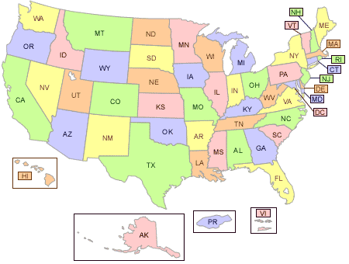
The Tenth Amendment
Powers not delegated (or entrusted) to the federal government are reserved to the states (or to the people)
Each state retains its sovereignty, its freedom, and its independence

