Slide 1
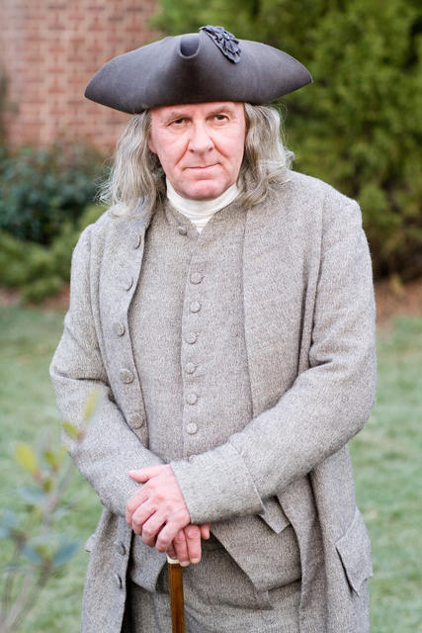
The Virtues for Moral Perfection, as Taught by Benjamin Franklin

Slide 2
The Words of the Rhetorician
1. Temperance
Eat not to dulness. Drink not to elevation.
2. Silence
Speak not but what may benefit others or yourself. Avoid trifling conversations.
3. Order
Let all your things have their places. Let each part of your business have its time.
4. Resolution
Resolve to perform what you ought. Perform without fail what you resolve.
5. Frugality
Make no expense but to do good to others or yourself; i.e., waste nothing.
6. Industry
Lose no time. Be always employed in something useful. Cut off all unnecessary actions.
7. Sincerity
Use no hurtful deceit. Think innocently and justly; and, if you speak, speak accordingly.

Slide 3
The Words of the Rhetorician [2]
8. Justice
Wrong none by doing injuries or omitting the benefits that are your duty.
9. Moderation
Avoid extremes. Forbear resenting injuries so much as you think they deserve.
10. Cleanliness
Tolerate no uncleanness in body, clothes or habitation.
11. Tranquility
Be not disturbed at trifles or at accidents common or unavoidable.
12. Chastity
Rarely use venery but for health or offspring—never to dulness, weakness, or the injury of your own or another’s peace or reputation.
13. Humility
Imitate Jesus and Socrates.

Slide 4
A Little Colometry…
1
Temperance
Eat not to dulness
Drink not to elevation
…
5
Frugality
Make no expense but to do good to others or yourself
i.e. waste nothing
…
7
Sincerity
Use no hurtful deceit
Think innocently and justly and if you speak
speak accordingly

Slide 5
A Little More Colometry…
10
Cleanliness
Tolerate no uncleanness in body
clothes
or habitation
…
12
Chastity
Rarely use venery but for health or offspring
never to dulness
weakness
or the injury of your own or another’s peace or reputation
13
Humility
Imitate Jesus and Socrates

Slide 6
Order
1. Temperance
2. Silence
3. Order
4. Resolution
5. Frugality
6. Industry
7. Sincerity
8. Justice
9. Moderation
10. Cleanliness
11. Tranquility
12. Chastity
13. Humility

Slide 7
Moral Perfection

Slide 8
Verb Usage
1. “Eat not…. Drink not….”
2. “Speak not…. Avoid….”
3. “Let…. Let….”
4. “Resolve…. Perform….”
5. “Make no…. …waste nothing.”
6. “Lose no…. Be always employed…. Cut off….”
7. “Use no…. Think…speak….”
8. “Wrong….”
9. “Avoid…. Forbear….”
10. “Tolerate no….”
11. “Be not….”
12. “Rarely use….”
13. “Imitate….”

Slide 9
Diction
“Temperance” is defined as “abstinence from alcoholic drink.”
“Moderation” is defined as “the avoidance of extremes in one’s actions or opinions” and “the process of moderating.”
“Chastity” is defined as “the practice of refraining from sexual intercourse.”
Franklin used the word “venery,” which is defined as “sexual indulgence.”

Slide 10
A Look at “Humility”
“Humility” is defined as “a humble view of one’s one importance.”
The online “Guide to the Scriptures” defines “humility” as the “condition of being meek and teachable. Humility includes recognizing our dependence upon God and desiring to submit to His will.”
Franklin’s treatment of Humility is profound…but simple: “Imitate Jesus and Socrates.”

Slide 11
A Few Figures of Speech
Each phrase is a proverb
The phrase “Resolve to perform what you ought. Perform without fail what you resolve” is an example of epanalepsis
The phrase “…and, if you speak, speak accordingly” is an example of anadipolsis
The phrase “Imitate Jesus and Socrates” is an example of meiosis (or understatement)

Slide 12
Aphorisms
“Eat not to dulness.”
“Avoid trifling conversations.”
“Waste nothing.”
“Lose no time.”
“Use no hurtful deceit.”
“Avoid extremes.”
“Imitate Jesus and Socrates.”
These phrases are laconic
These are memorable statements of opinion

Slide 13
Conclusions
Franklin’s prose is…
Correct
Complete
Appropriate
Distinct
Brief
Clear
Common
Instructive, inspiring, and delightful
Charming and sublime
Without hyperbole, metaphor, or excessive adornment
Strong, not weak

Slide 14
Any Questions?

