Slide 1
Disclaimer:
The following presentation is not intended to be an expression of disrespect for Jesus Christ.
Rather, the images herein are intended to represent a variety of differing views and/or beliefs concerning the subject matter: “Jesus.”
Think critically.

Slide 2
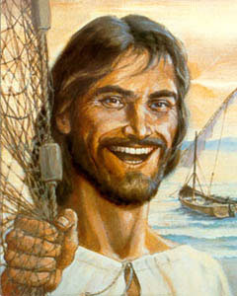
Novica Tadic’s “Jesus” (205)

Slide 3
“Jesus”
By Novica Tadic
Jesus
Our Jesus
Our Jesus a pincushion

Slide 4
Three Jesuses
“Jesus” (No more, no less)
“Our Jesus”
(A possession? A friend? A…?)
“Our Jesus a pincushion”
(Is this disrespectful…satirical…or something else?)

Slide 5
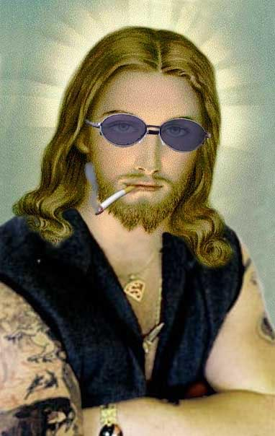
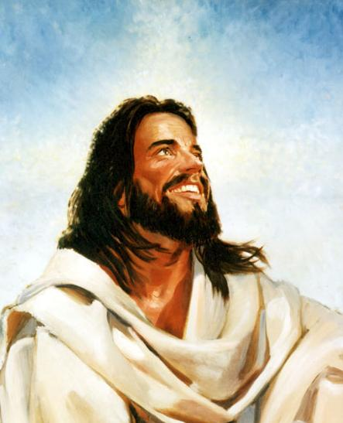
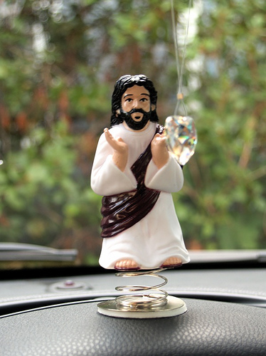
Which Jesus do you worship?

Slide 6
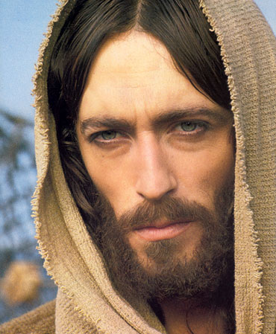
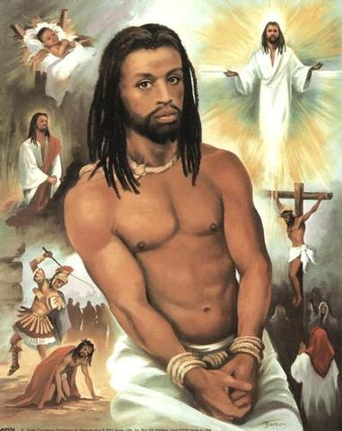
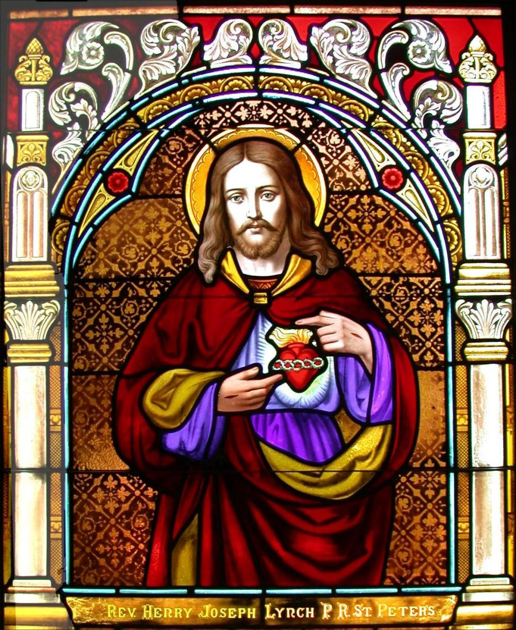
Which Jesus do you worship? [2]

Slide 7
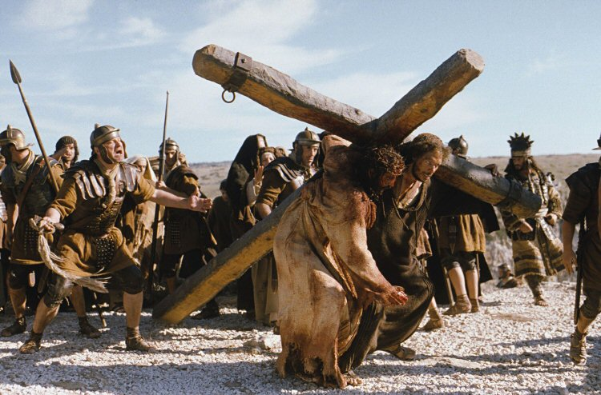
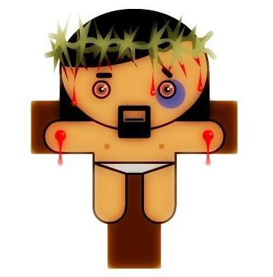
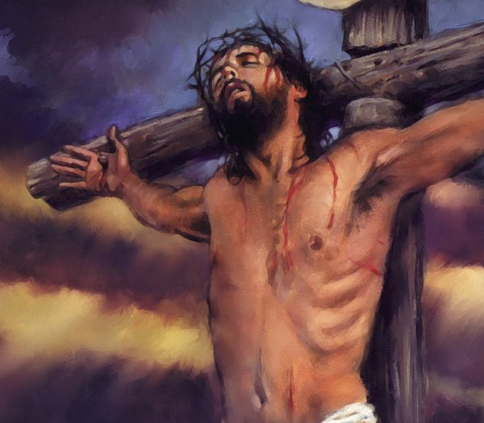
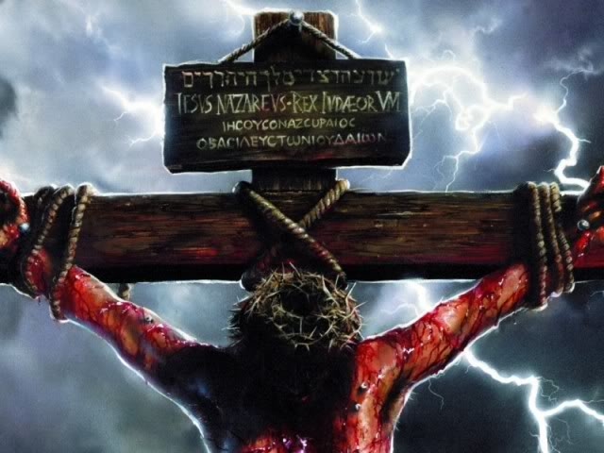
Which Jesus do you worship? [3]

Slide 8
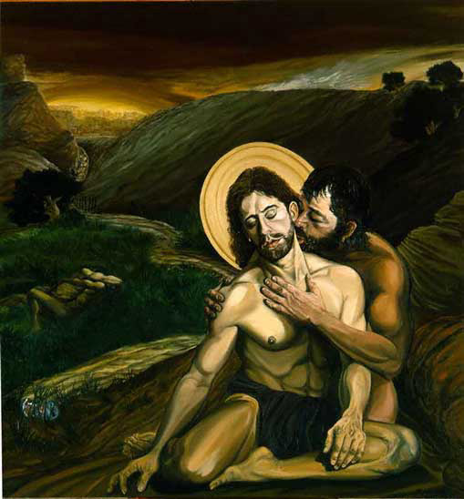
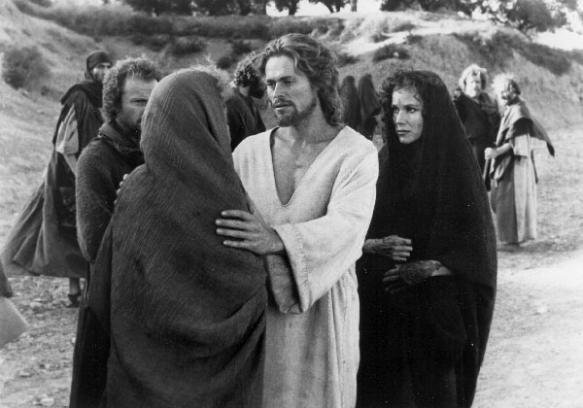
Which Jesus do you worship? [4]

Slide 9
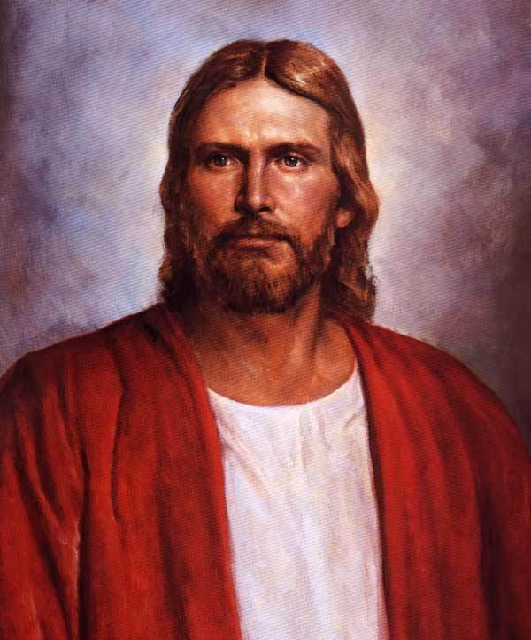
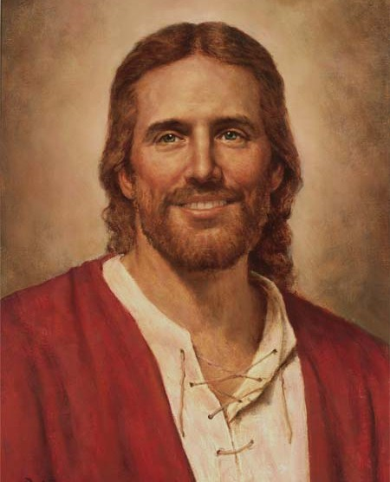
Which Jesus do you worship? [5]

Slide 10
All images from images.google.com
Thank You.

