Slide 1
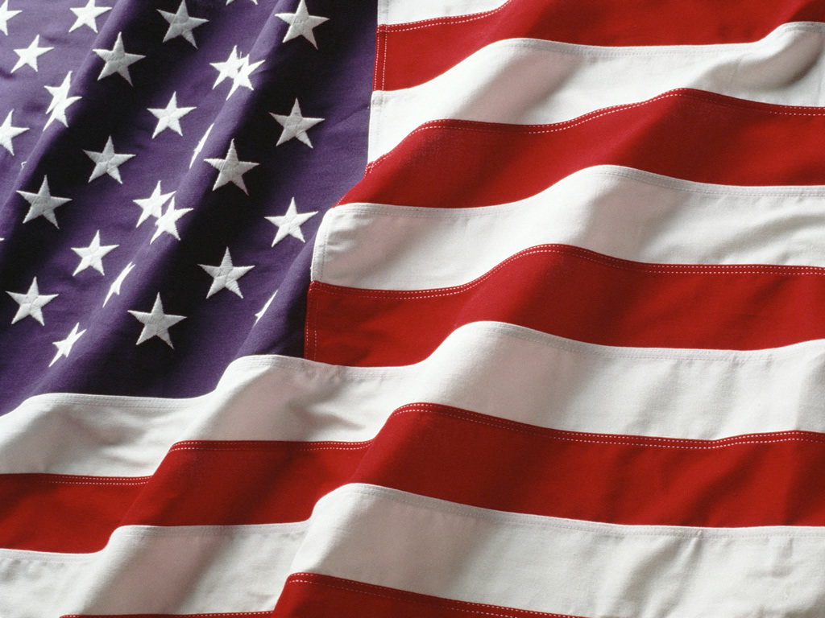
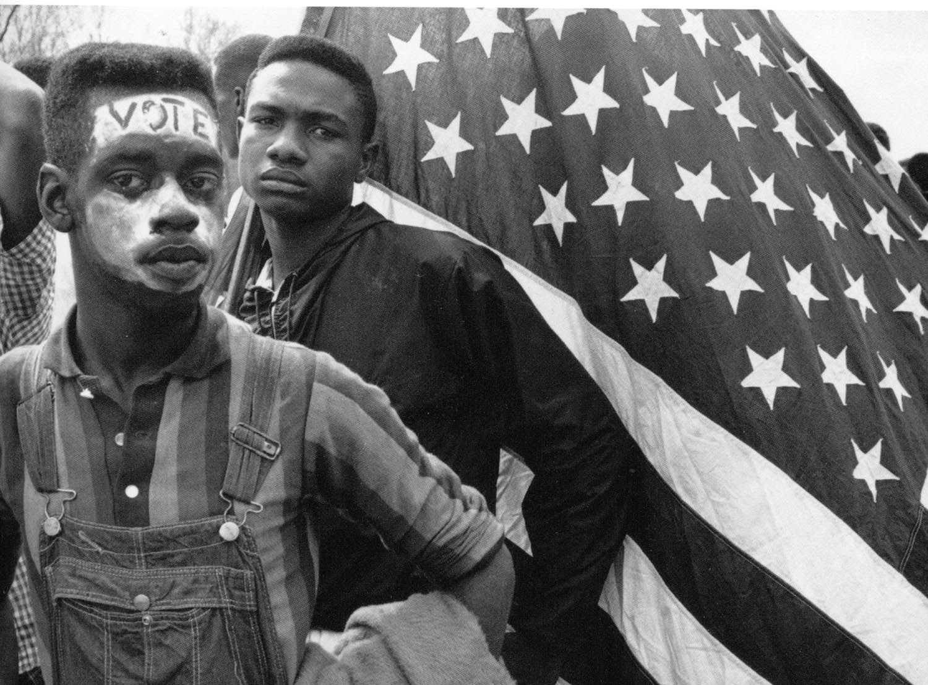
Your Right to Vote

Slide 2
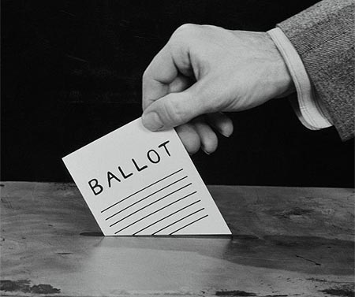
Voting Requires Choices
To vote is to choose, take part in an election, or take part in a ballot
Voting is considered “a civic virtue”

Slide 3
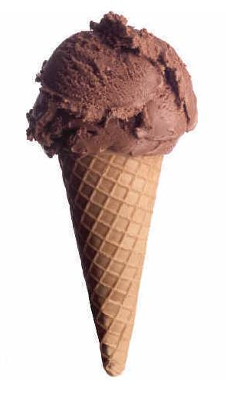
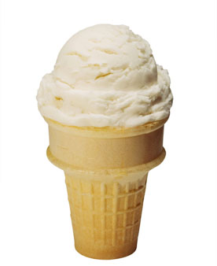
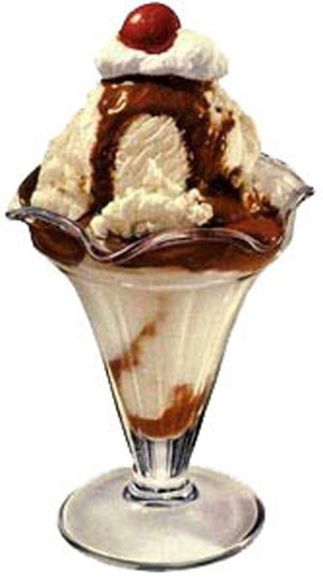
Voting Requires Choices [2]
Do you prefer chocolate ice cream…vanilla ice cream…or something else?

Slide 4
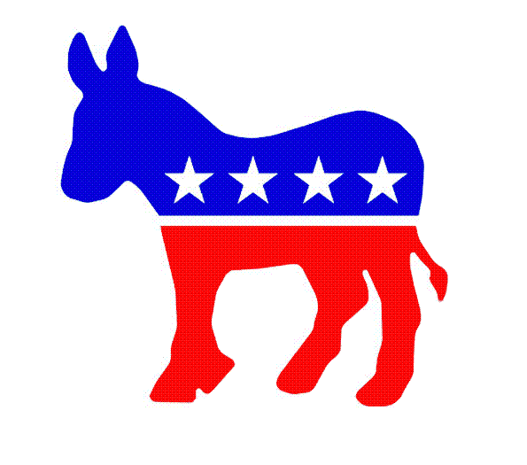
Your Political Choices
Vote Democratic!

Slide 5
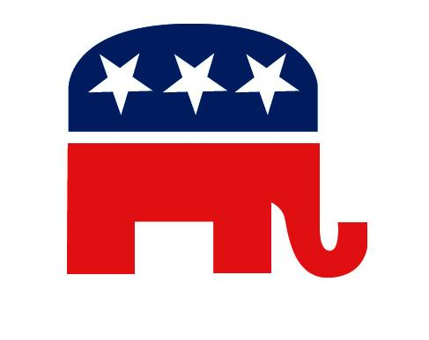
Your Political Choices [2]
Vote Republican!

Slide 6
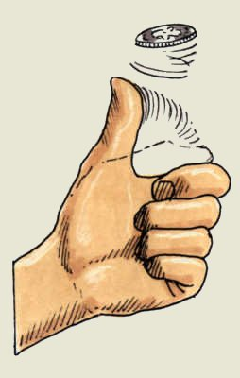
Your Political Choices [3]
Flip a coin!

Slide 7
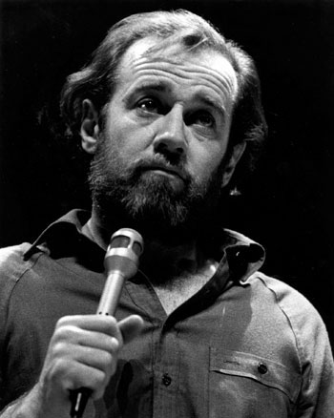
Your Political Choices [4]
Vote for nobody! Nobody tells the truth; nobody keeps promises; nobody listens to your concerns; nobody helps the poor; nobody represents you; nobody cares. A vote for nobody is a vote for everybody!

Slide 8
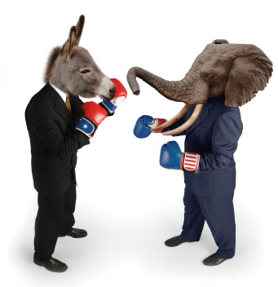
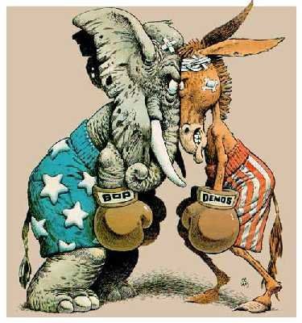
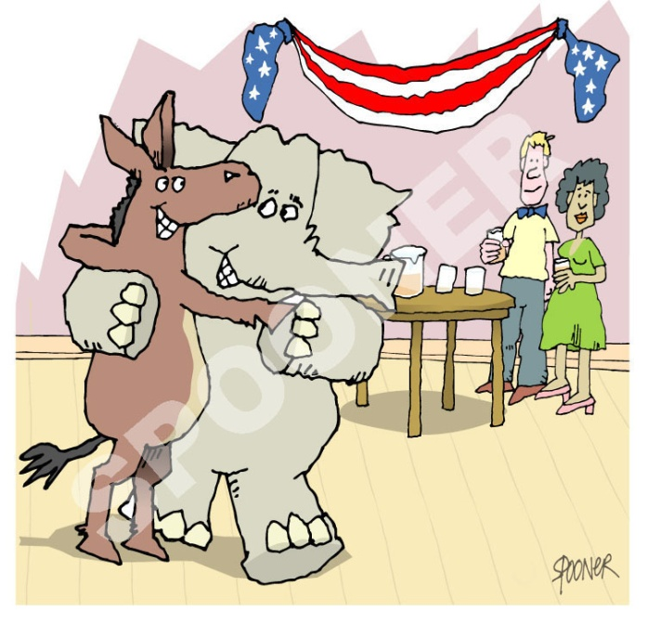
Is our two-party system limiting our choices?
Do we ever see political indecision?

Slide 9
Words of Wisdom
“Democracy is two wolves and a lamb voting on what to have for lunch.”
– Benjamin Franklin, printer
“Always vote for principle, though you may vote alone, and you may cherish the sweetest reflection that your vote is never lost.”
– John Quincy Adams, 6th president
“If voting made any difference, they wouldn’t let us do it.”
– Mark Twain, author
“The ballot is stronger than the bullet.”
– Abraham Lincoln, 16th president
“The people who cast the votes don’t decide an election, the people who count the votes do.”
– Joseph Stalin, communist dictator

Slide 10
Words of Wisdom [2]
“Democracy is being allowed to vote for the candidate you dislike least.”
– Robert Byrne, author, billiards champion
“I hope that no American will waste his franchise and throw away his vote by voting either for me or against me solely on account of my religious affiliation. It is not relevant.”
– John F. Kennedy, 35th President
“The best argument against democracy is a five-minute conversation with the average voter.”
– Winston Churchill, Prime Minister
“Bad politicians are sent to Washington by good people who don’t vote.”
– William E. Simon, 63rd Secretary of Treasury

Slide 11
Words of Wisdom [3]
“Voting at the local level—say, in a town of 100 or even 20,000 persons—makes more sense to me than voting for the president. We never voted for the president—the Electoral College decided that matter.”
– Anonymous

